Slide 1
Economic & Regulatory Capital, Credit Risk and Pricing Topic Three Capital PD, LGD and EAD Model Development

Slide 2
Overview
Credit scoring is a systematic means by which banks and other financial institutions can gather information about borrowers or applicants for loans regarding their creditworthiness
Credit scores are used in automated decision processing and for financial risk management
Credit scoring makes use of many advanced and sophisticated methods from statistics and data mining. It is a triumph of applied statistics

Slide 3
What is scoring?
Scoring is a way to grade or rank the risk of an event.
Scores are used in many different application areas.
Physiology score: Provides a measure of the severity of illness of patient in critical care
Marketing propensity score: Score on individuals related to their chance of take-up of a campaign
Fraud score: transaction level score to indicate fraud
So scoring is applicable in many different areas. Underlying concepts are the same, regardless of application.
How would you score a movie, lecture, customer?

Slide 4
Aims of Scoring
Fundamentally, the aim of credit scoring is to provide banks with intelligence about the borrower (or applicant) that allows them to assess risk and potential reward.
Particular common aims can be categorised as follows: either as part of a
Decision process or
Probability estimation – calibration step

Slide 5
Decision Process
Application scoring: Use scores to decide who to accept or reject for a loan or other financial product
Behavioural scoring: Use scores to determine how well-behaved existing borrowers are, anticipate future problems and inform pay / no pay decisions
Fraud detection: Use scores to detect unusual credit use which may be the result of fraud
Cross-selling: Decide who to target for additional financial products
Debt Management: Decide who to target for early intervention or for particular supports

Slide 6
Consumer Credit
For consumer credit, the credit score is used to determine the creditworthiness of an individual applying for (or with) a loan, credit card or other financial product
Credit scores may be calculated by banks and became essential when banking became a mass market activity
Often generic scores are bought from credit bureaus such as:
Experian
FICO
Equifax
CRIF
Irish Credit Bureau

Slide 7
Experian UK

Slide 8
Equifax UK
Equifax Score 500
Your score is highly predictive that you would be a strong candidate for credit
You are well above the average for UK borrowers
Most Credit grantors would consider this score excellent
You will probably not be turned down for loans based on your score alone.

Slide 9
Irish Credit Bureau Scores
The range of scores for different ICB scales is below - CRIF built ICB scores .
Score Lowest Score (Highest Risk) Highest Score
ICB CRIF 3* 271 555
ICB CRIF 2* 330 550
Global FICO Score (GFS) 300 850
Not all ICB Members request a score from ICB. If a score is not present for an enquiry on your report, it is because the member who made the enquiry did not request it, the loan(s) has been opened very recently, or there has been no activity on the loan(s) for some time.
* Note: A score value of 50 is automatically returned for an Account Holder with an account that is 3 months (or more) in arrears (ICB CRIF 3), or has been 3 months (or more) in arrears during the preceding 3 months (ICB CRIF 2). Profile Indicators such as 'W' (Written Off), 'P' (Pending Litigation), etc. also qualify for a score value of 50.
www.icb.ie

Slide 10
Who is CRIF?
Founded in Italy in 1988, CRIF is the leading provider in continental Europe of banking credit information, one of the key players worldwide providing integrated services and solutions for business & commercial information and credit & marketing management.
More than 3,300 banks and financial institutions, 44,000 business clients and 167,000 consumers use CRIF services in fifty countries.
CRIF is an independent company with 90% of its capital held by founder members and management, and the remaining 10% by various credit institutions. Among the latter,three3 international banks have been present in the shareholding group since the 1990s, namely BNL-BNP Paribas, Deutsche Bank and Banco Popolare
CRIF manages the Central Credit Register for the CBI.

Slide 11
CBI Central Credit Register
Every month lenders submit information on loans of €500 or more to the Register. This information is used to generate individual credit reports on borrowers which they and, in certain circumstances, lenders can access. Borrowers can request their credit report to see the credit information lenders have submitted on their loans. Lenders can use credit reports to get a picture of a borrower’s current lending and credit history. This can help them to decide if they should approve an application for a loan or not.
The Central Bank uses the Register to get better insights into the level and patterns of lending in the economy
The CBI does not intend to use the CCR to introduce a credit scoring system in the Irish economy!!

Slide 12
Why Formal Models?
Up until the 1980’s, most loan applications were assessed by a bank officer who would use his/her judgement to decide whether the loan was provided based on their personal view of the applicant. It would also be their responsibility to monitor the loan.
Now almost all loans are assessed and monitored using automated formal models. Why did this change?
Performance. There is some evidence that, even with their expert judgement, bankers do not perform as well as formal models in choosing who is best to give a loan to.
Technology. Advances in computing technology enabled an explosion in consumer credit; it requires a fast automated system to process the huge number of applications this generated.

Slide 13
Why Formal Models?
Objectivity: The judgement of banking staff is highly subjective, meaning there is a lack of consistency in their decisions. In contrast, formal systems provide a highly objective means of decision making.
Two bank officers may make different decisions in the same case
Or, even the same bank officer may make a different decision based on mood: whether they are tired, irritable, happy, etc.
Transparency: Formal systems provide a fully transparent system and equality between applicants (adjusting for genuine risk factors). This is a legal requirement and is demanded by regulatory authorities.
Cost: Using automated formal systems tends to be cheaper.

Slide 14
Consumer (Retail) Credit
Perfect place to apply scorecards
Mortgage loan: Loan secured on a physical property
Credit card *: Credit availability with upper credit limit and no fixed repayment plan
Personal loan: Loan with fixed repayments over time (secured or not)
Overdraft *: Credit limit available in current account for a fee and usually a limited duration
Hire purchase: Hire item with fixed payments, with final ownership
The products can be offered to small businesses or sole traders and are still categorised as retail credit
* Examples of revolving credit

Slide 15
Wholesale Credit Portfolios
Sovereign
Bank
Large Corporate
Small Corporate
Commercial Real Estate
Bespoke / Specialist Portfolios
Scorecards less likely to be deployed for decisioning but are needed for capital and IFRS 9 modelling.

Slide 16
Probability Estimation
Forward looking: Major breakthrough in modelling
Allows for quantitative risk management and measurement of expected profitability/return
Inform pricing decisions
Capital PD is input to capital requirement calculations
Provisions PD is input to ECL (not the same PD)
How do banks adapt models to SI559 rules?

Slide 17
Which Formal Models are Available
The standard model for credit scoring is logistic regression
Logistic regression is the appropriate regression analysis to conduct when the dependent variable is dichotomous (binary)
In credit scoring the binary outcome is usually default / not
Logistic regression is used to describe data and to explain the relationship between one dependent binary variable and one or more metric (interval or ratio scale) independent variables
The attraction is that the predictor variables can be qualitative (married, home owner), discrete numerical variables (number of children, number of qualifications) or continuous numerical variables (age, income, average account balance).
Calibration is the process to map score to log odds to odds to PD

Slide 18
Iconic Models
Iconic models enable us to impose prior assumptions before building the model.
These assumptions would be based on expert (human) judgement.
Iconic models may be more meaningful and robust over time.
Examples
An iconic approach would be to segment a credit scoring model into two parts, based on the prior belief that the risk factors for high earners would be different than low earners.
A mortgage scorecard may segment owner occupier and buy to let applications on the assumption that they are different populations with different default drivers.
Iconic models may include particular variables in the belief that they are predictive, even if the evidence is not yet available
How will SI559 rules change mortgage scorecards?

Slide 19
Empirical Models
Empirical models use minimal prior assumptions about the data.
If there is a predictive association between a variable and the outcome then it is reasonable to include in the model.
Credit scoring is very empirical and empirical models have proved very successful. However, empirical models present some potential problems.
They may identify spurious associations.
A bank may be legally required to justify decisions: could they do it in this case? For instance, what if the colour of the applicant’s car was found to associate with credit risk?
Empirical models may be prone to degradation, since they are built within a specific time frame. Some of the risk factors they employ may be time dependent. We test models “out of time”.
Often empirical models have an iconic component.

Slide 20
Building a Scorecard
Select a sample of ‘goods’ and ‘bads’
Identify possible factors (quantitative and qualitative)
Build data set
Single factor analysis of data
Multi-factor analysis and calculation of score
PD Steps
Score to grade mapping typically
Calibration of grades to probability of default

Slide 21
Building a Scorecard
Data collection – Goods and Bads, based on agreed definition
Three data segments – model build, model testing, model validation
Scorecard definition may not be the “real definition”. Maybe Bad is two payments missed rather than three to enhance number of bads
Assess model performance
Gini coefficient
Validation sample
Out of time test
Business challenge

Slide 22
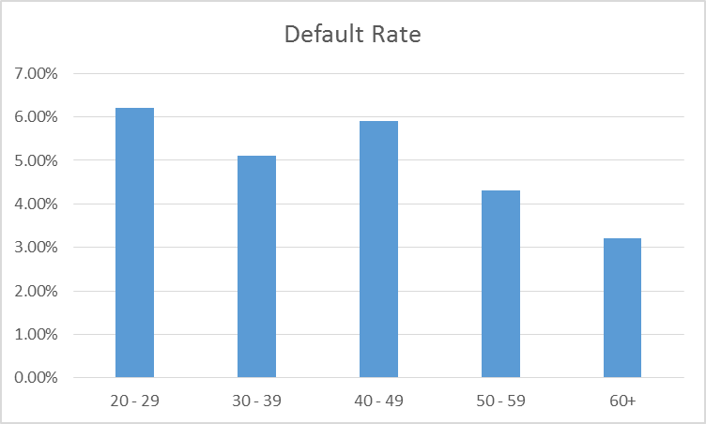
Risk Factors and Credit Score
There are many characteristics of borrowers which are risk factors in the sense that they are associated with default
For instance, consider this graph linking age with default rates for a portfolio of loans.
There is a general reduction in risk with age. Should age form part of the credit score?

Slide 23
Retail Rating Model
1. Capacity: Is the borrower capable of repaying the loan? (e.g. income, current account balance)
2. Capital: What is at stake to the borrower if the loan goes bad? (e.g. mortgage deposit, car deposit)
3. Collateral: What assets can the borrower offer if the loan is not repaid?
4. Conditions: What is the intended purpose of the loan?
5. Character: What is the borrower like? Is he/she trustworthy?

Slide 24
Corporate Rating Model
Quantitative (financial) factors
Gearing and Leverage
Profitability
Debt Capacity
Debt Service
Liquidity
Trends in key variables
Size
Age of company
Qualitative (non-financial) factors
Management Quality
Sector Potential
Ownership Structure
Bank Relationship
Financial Reporting
Sector Competition
Income Stream Diversity

Slide 25
Single Factor Analysis
Key Question – does this factor tell you anything about default of customers - was there any difference between good and bad customer regarding this aspect
Good Factor
Not a Factor

Slide 26
Multi Factor Analysis
Factor 5
Factor 7
Factor 4
Factor 9
Factor 3
Factor 8
Factor 2
Factor 6
Factor 1
Looking for factors which provide as much “added information value” as possible. he final model needs to be workable so there will be a maximum number of factors (10 – 12) which will be used.

Slide 27
Credit Scoring Variables
We want to build a multivariate model that combines all credit risk factors that are available to produce an overall assessment of risk.
The overall assessment of risk (or creditworthiness) is captured in the credit score
Therefore, the credit score is not a quantity that is directly measured from an individual
It is computed by the bank as an indicator of creditworthiness
Therefore, the credit score is a latent variable
It is inferred from observed variables or characteristics
It is about an individual, but is not directly measurable
It is variable and changes over time with behaviour

Slide 28
Scorecard Performance
Lets imagine a good scorecard. We might measure the cumulative number of defaults against the cumulative scores. So, we see what percentage of defaults are in the
bottom 10% of scores
Next 10% of scores
And so on:

Slide 29
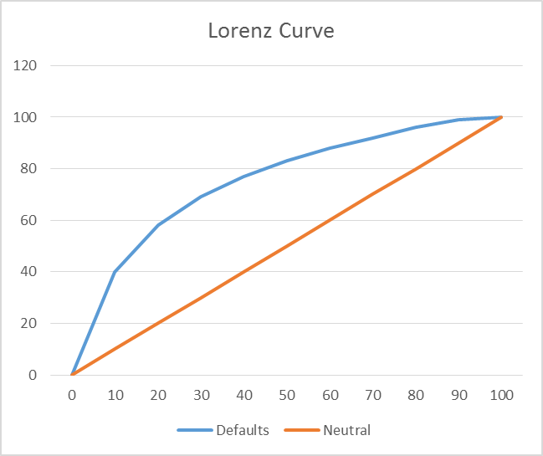
Picture of Performance
We might present this information on a graph as follows:

Slide 30
Gini Coefficient
Counts cumulative defaults against cumulative score
Diagonal line is random guesswork
Area between the curves measures performance
Gini is twice the area between the curves
2 in formula puts it on a scale [0 , 1]
Kolmogorov Smirnov statistic measures the maximum vertical gap between the two curves
A good score for either statistic depends on the context

Slide 31
Scorecard Performance
Performance on validation sample
Test scorecard out of time if possible
Monitor scorecard performance, maybe with a weaker definition of performance for portfolios with low numbers of defaults
Review the number of variables in the scorecard – avoid over fitting the data

Slide 32
Generic Customer Credit Scores
Generic credit score: These are general scores, rather than product scores, about individuals based on
individual characteristics (age, income, home ownership, etc) and
credit history (number of times they have defaulted in the past, etc).
Generic scores are not linked to particular loan products. Effectively they are customer level rather than product level scores. Generic scores are often provided by credit bureaus.

Slide 33
Product Credit Score
These are built by banks and financial institutions to compute creditworthiness for specific loan products
Credit scores will be computed from past data about borrowers with the same (or similar) loan product
For a specific product, custom credit scores are likely to be more accurate than generic scores
Generic scores can be used as a variable within a custom credit scoring model
Conversely, some institutions may compile a generic credit score as a combination of individual custom or product credit scores

Slide 34
Applicant Information
Typical information requested
Employment status
Profession
Time with employer
Income
Outgoings
Age
Residential status
Assets (property, savings)
Other borrowings
Length of time in residence
Number of dependents
Collateral information
Ireland
Irish Credit Bureau
CRIF 3 Score
Central Credit Register
Institution Customer Score
Institution Product Score
Banked Customer
Account turnover
Average balance
Debits / Credits over time
Time in arrears
Maximum arrears

Slide 35
Remember: 5 x C for Mortgages
1. Capacity: Is the borrower capable of repaying the loan? (CBI Rules) Income, Expenditure, Savings?
2. Capital: What is at stake to the borrower if the loan goes bad? (CBI Rules and exceptions)
3. Collateral: What assets can the borrower offer if the loan is not repaid? (Property type and location)
4. Conditions: What is the intended purpose of the loan? (Owner Occupied or Buy to Let)
5. Character: What is the borrower like? Is he/she trustworthy? (CRIF score, banked customer v non-banked customer). Married? Children?

Slide 36
People stop paying mortgages because they …
Break up with a partner
Lose their job
Lose their health
Lose hope (at least this one connects to a variable – LTV)
How does this tally with scorecards – I don’t see any of this in scorecards?
Is there a difference between real life and statistics – are we painting a pale imitation of reality and congratulating ourselves for our intelligence?

Slide 37
Potential Personal Retail Scorecard
Variable
Age | <30 | 30 - 39 | 40 - 49 | 50 +
Points | 12 | 23 | 32 | 47
Education | N / A | L.C. | Trade | Degree
Points | 18 | 20 | 32 | 38
Borrowing | < 5K | 5K < 15K | 15K +
Points | 45 | 32 | 27
Homeowner | Yes | No
Points | 56 | 12
Credit Ref. | Pos. | None | Neg.
Points | 35 | 22 | 11
Employment | Perm. | Cont. | P. T.
Points | 46 | 42 | 29

Slide 38
Corporate Credit
Who are they (KYC):
Type of borrower - legal capacity
Relationship / New
Group / Connection
Track record / Reputation / Integrity
Borrower Strength / Risk Profile (Financial / People / Prospects)
Industry / Market Conditions
Environment they are operating in
Their position in industry / competition
What do they want
Purpose of Finance
Product / Term / Conditions / Complexity
What are they offering – security?
What risk are they taking?
What are we interested in – aligned ?
Strategy / Portfolio / Connection / Sector
Risk Appetite / Policies
Credit Bureau
S&P
Moody
Fitch

Slide 39
Scorecard Decisions
Definition of Bad
Algorithms for missing data
Average score for variable
Worst score for variable (conservatism in capital)
Nearest neighbour technique

Slide 40
Probability of Default Calibration
This is the probability that an obligor will default before the maturity of the contracted obligation to pay. It is called the probability of default (PD).
Basel / CRR Definition - Art 178
Article 178 (1) Default of an obligor
A default shall be considered to have occurred with regard to a particular obligor when either or both of the following have taken place:
(a) the institution considers that the obligor is unlikely to pay its credit obligations to the institution, the parent undertaking or any of its subsidiaries in full, without recourse by the institution to actions such as realising security;
(b) the obligor is past due more than 90 days on any material credit obligation to the institution, the parent undertaking or any of its subsidiaries.
In the case of retail exposures, institutions may apply the definition of default laid down in points (a) and (b) of the first subparagraph at the level of an individual credit facility rather than in relation to the total obligations of a borrower.

Slide 41
Probability of Default
1st we need to define what is being measured ;
What constitutes a default ?
Missed payment – if so how many?
Covenant breach?
Defaulted elsewhere?
Paying but looks unlikely to pay some time in the future?
Event – examiner / receiver appointed…?
Not paying but sufficient security?
Materiality threshold?
Actual threshold?
Relative threshold?
Point in Time (PIT) or Through the Cycle (TTC) measurement?
Based on todays conditions & environment ?
Average measurement over an economic cycle?

Slide 42
Building a PD Model
Select a sample of ‘goods’ and ‘bads’
Identify possible factors (quantitative and qualitative)
Build data set
Single factor analysis of data
Multi-factor analysis and calculation of score
PD Steps
Score to grade mapping typically
Calibration of grades to probability of default

Slide 43
Score to Grade to PD for Capital Models
Highlights of Article 170
a rating system shall have an obligor rating scale which reflects exclusively quantification of the risk of obligor default. The obligor rating scale shall have a minimum of 7 grades for non-defaulted obligors and one for defaulted obligors
avoid undue concentrations of obligors in a particular grade
Highlights of Article 179
an institution's own estimates of the risk parameters PD, LGD, conversion factor and EL shall incorporate all relevant data, information and methods
an institution shall add to its estimates a margin of conservatism that is related to the expected range of estimation errors. Where methods and data are considered to be less satisfactory, the expected range of errors is larger, the margin of conservatism shall be larger

Slide 44
PD Continued
Highlights of Article 180
Commercial: institutions shall estimate PDs by obligor grade from long run averages of one-year default rates
irrespective of whether an institution is using external, internal, or pooled data sources, or a combination of the three, for its PD estimation, the length of the underlying historical observation period used shall be at least five years for at least one source. If the available observation period spans a longer period for any source, and this data is relevant, this longer period shall be used
institutions shall estimate PDs by obligor grade or pool from long run averages of one-year default rates

Slide 45
LGD Estimates
Extracts from Article 181
institutions shall estimate LGDs by facility grade or pool on the basis of the average realised LGDs by facility grade or pool using all observed defaults
institutions shall use LGD estimates that are appropriate for an economic downturn if those are more conservative than the long-run average
for exposures to corporates, institutions and central governments and central banks, estimates of LGD shall be based on data over a minimum of five years, increasing by one year each year after implementation until a minimum of seven years is reached, for at least one data source. If the available observation period spans a longer period for any source, and the data is relevant, this longer period shall be used
for retail exposures, estimates of LGD shall be based on data over a minimum of five years. An institution needs not give equal importance to historic data if more recent data is a better predictor of loss rates
EBA shall develop draft regulatory technical standards to specify the nature, severity and duration of an economic downturn

Slide 46
LGD Model Construct
What does an LGD model look like?
What happens post default?
Some people cure – no loss associated with these
Some cure with assistance – loss estimate?
Others do not cure
Establish Loss Given Loss (LGL) estimate for these
Collateral repossession – when? This is Time to Recovery.
Discount rate for future cash flows – EBA and PRA give different advice
Include other costs
Conservatism

Slide 47
Validation of PD models
Typically PD approximately doubles from one grade to next
Banks need to ensure that the PDs associated with each rating accurately predict actual default rates.
Each individual factor should also be validated to ensure that it is still predictive.
Calibration of score to PD must be monitored and readjusted if required.
A model will go through an independent validation process pre launch ( see model governance)
Out of sample validation
Out of time validation
Independent validation team
When operational its accuracy must be regularly retested / validated.
Model may need adjusting / redevelopment / recalibration if;
Observed default experience was not as expected - accuracy / model power issues
Model Overrides High – model issue?
Factor Shift - Factors becomes less relevant over time / customer behaviour changes
Population Shift – model build based on one “population” but loans now to a different type of “population” – SI559

Slide 48
Number of models
Banks will have numerous PD models - relevant for each exposure class / “risk portfolio” . Risk Portfolio – homogenous customers / similar risk characteristics/ risk profile.
For example a Bank may have the following Model suites for it’s Credit Portfolios;
Sovereigns
Financial Institutions
Large Corporate PD Model
Mid Corporate PD Model
Small Corporate PD Model
Speciality Market / Sector / Product PD Models
Personal Unsecured
Mortgage
Credit Cards
Overdrafts
Small Commercial Loans
Small Commercial
The need to develop models for portfolios / sub portfolios will be based on the degree to which the risk profile / default behaviour is different from portfolio to portfolio.
Consider level of added accuracy vs ability to develop and maintain model suite
Cost of model maintenance is becoming a major issue for banks

Slide 49
Credit Capital Considerations
Potential Process Issues with capital calculation:
Default recognition
DPD90 – capital default even if caused by process issue
Customer grading up to date – overdue annual reviews?
Quality of customer grading – good to bad overnight?
Unused limits / marking up of limits
Up to date valuations for LGDs / valuer
Appropriate recognition of mitigation / offsets
Capital - we have a provision therefore capital is not important
Recording of turnover – discount for SMEs
Bad book
Lack of understanding of models, model development, capital use
49

Slide 50
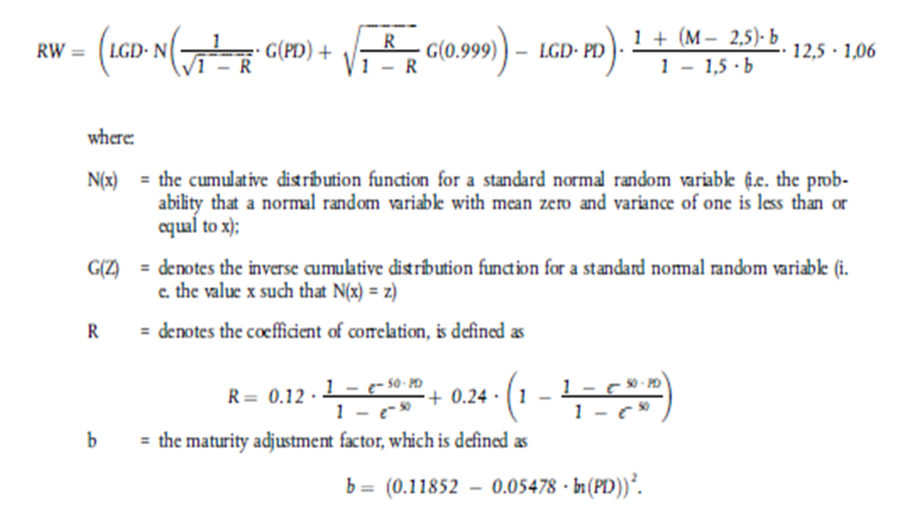
RWA Basel Formula
Maturity Adjustment
RWA converter (8%)
Worst case at 99.9% Confidence level
Scaling factor - 6% uplift
Less EL
(PD*LGD)
Deduct Expected loss
Assumed to be covered by Provisions
(capital deduction if there is a shortfall)
UNEXPECTED LOSS (Worst Case – EL = UL)
Unexpected loss - to be covered by Capital
Only 3 Input Variables
PD
LGD
Maturity
( R – Correlation is given per exposure type )

Slide 51
Regulatory Divergence SSM v PRA
Definition of Default
LGD Model Constructs – Discount Rate
Data Lineage
Template completion
Benchmarking Approaches
PD Calibration Approaches
Post Brexit – CP 16/20 from PRA
51

Slide 52
Since last week: CBI
Speech by Deputy Governor on 19th February 2021
Speech provided with supporting slides
Is the banking system safer than now than it was a week ago?
Reference to counterfactual position:
https://www.centralbank.ie/docs/default-source/publications/financial-stability-review/financial-stability/financial-stability-review-2019-ii---analyst-briefing.pdf?sfvrsn=4

